Slide 1
An Introduction to
Managing Projects
Wayne Seames, Chester Fritz Distinguished Professor
Chemical Engineering
October 19, 2021

Slide 2
Talk Outline
Projects and the project life cycle
The levels of design and design projects
Planning concepts
Implementation plans and schedules
Teamwork and leadership
Wrap-up
Q&A
2

Slide 3
Projects and the Project Life Cycle
Project: Determining and/or implementing the solution to an opportunity
Opportunities:
May be of necessity – a piece of equipment or component breaks or wears out
Due to new discoveries from research, ideas generated from literature, conferences, visiting other companies, or from customer feedback.
Due to the results of a market survey that might reveal a new market calling for an expansion or adaptation of current capabilities.
Due to a new regulation
To correct problems encountered in an existing process or product
Opportunities may also be defensive, where the company feels a need to respond to the actions of a competitor in order to maintain market share.
3

Slide 4
Projects and the Project Life Cycle
Almost all projects are driven by economics!
Projects involve capital investment and/or human resources
Company’s goal: produce profits - projects must demonstrate a given level of profitability (known as the hurdle rate or minimum acceptable rate of return)
4

Slide 5
Projects and the Project Life Cycle
Projects that don’t make a profit
Replacements
Safety-related
Environmental or other regulation-related
Must still demonstrate that project is most economical (lowest life cycle cost) way to satisfy the constraint
5

Slide 6
Projects and the Project Life Cycle
Why should I care about projects?
90+% of all Engineers
will be involved in projects
at some time in their career!
6

Slide 7
The Ideal Project Life Cycle:
The optimum progression of events that should occur to design and/or implement the best set of facilities and systems to satisfy an opportunity.
7

Slide 8
A Realistic Project Life Cycle:
A near optimal progression of events that should occur to design and/or implement one of the best set of facilities and systems to satisfy an opportunity.
Shortcuts in the project life cycle are the most common cause of project delays and cost overruns.
8

Slide 9
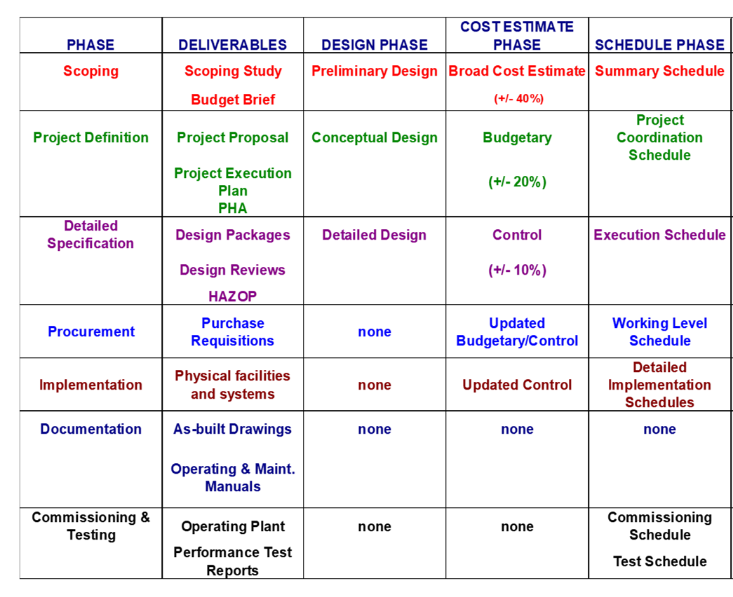
7-Phase Project Life Cycle
Determine if the opportunity is worthwhile and if so, what is a near optimum scope of work
Define the exact scope of work; the exact plan for execution
Specify the exact physical and software resources needed

Slide 10
An Alternative Lifecycle for Computer Technology Projects
PAS = technology system being developed/implemented

Slide 11
Use the Project Life Cycle:
Understand the project life cycle for your project
Stay at the correct level of detail for each phase of the lifecycle
  – this will avoid unnecessary work
  – more time efficient and cost effective
11

Slide 12
LEVELS OF DESIGN
Preliminary Design
  Provide an overview of the project adequate to perform a Category 4 (broad, factored) cost estimate and economic analysis (+/- 30-40% level)
Conceptual Design
  Specify the exact scope of work for the project
Detailed Design
  Specify the exact systems and facilities required to execute the project – specify what will be purchased and built
12

Slide 13
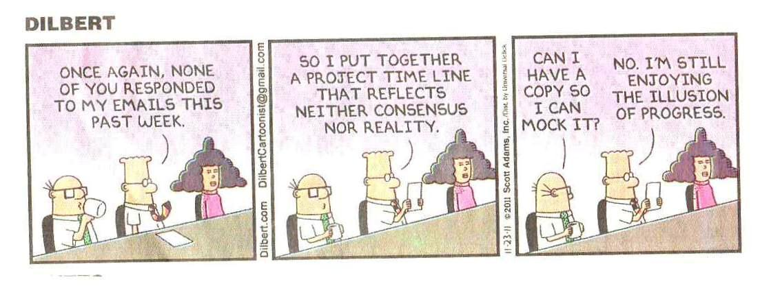
The Key to Successful Projects:
Planning
The process of developing a schedule
13

Slide 14
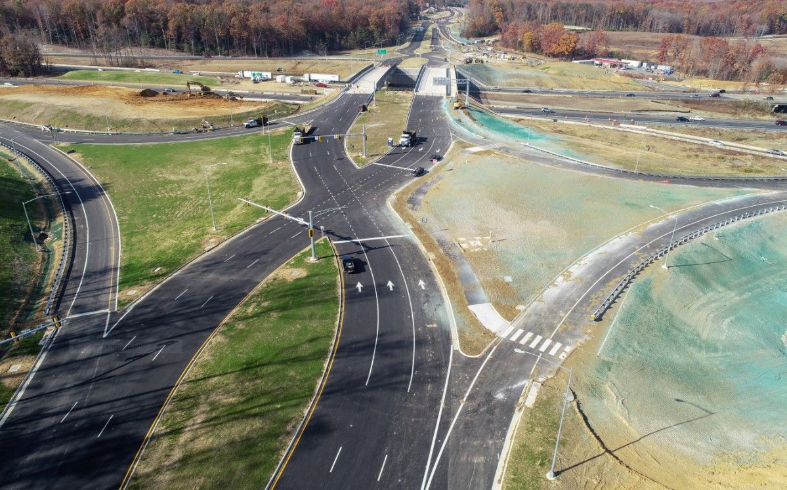
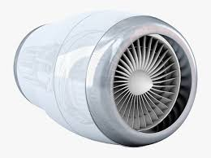

Project Schedules
Good schedule ➔ Better Economics
Too optimistic: miscoordinate the work
Too conservative: extended labor and equipment usage costs
Good schedule = accurate and efficient
Coordination is more important than speed for efficiency
Correct design is more important than fast design
14

Slide 15
Project Planning
The most common method is the Critical Path Method CPM
Project is divided into a series of tasks and milestones.
Define milestones 1st, then the tasks required to meet the milestones.
15

Slide 16
Tasks and Milestones
Milestone: A point where a series of related tasks have been completed and progress can be measured.
EXAMPLE: The preliminary design is complete
Task: A single activity required by the project
EXAMPLE: The flow rate and horsepower required by a pump has been estimated.
16

Slide 17
The Critical Path Planning Method
Project is divided into a series of tasks and milestones.
Prerequisite: task that must be started/finished before a 2nd task can be started/finished.
FS = finish to start prerequisites: finish task 1 before task 2 can start
FF = finish to finish prerequisites: finish task 1 after task 2 starts, but before task 2 can finish
17

Slide 18
The Critical Path Planning Method
Critical Path: The path through the schedule that takes the maximum time, start-to-finish.
Float: excess time built into a task, milestone, or entire project where resources are not being utilized
  All tasks not on the critical path contain float when compared to the critical path
  To reduce project time, you only have to reduce times for tasks on the critical path.
18

Slide 19
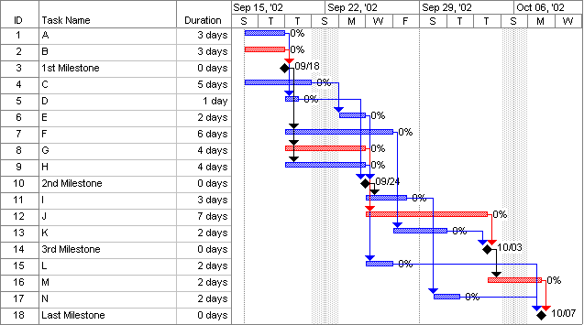
The Critical Path Planning Method
CP in red
19

Slide 20
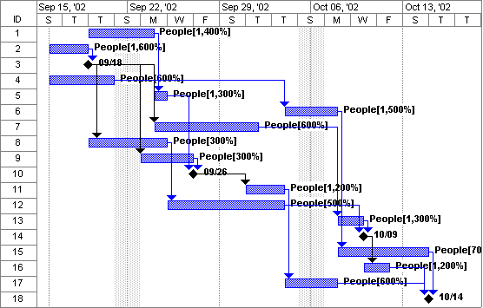
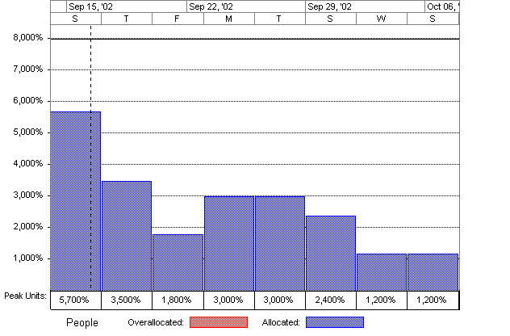
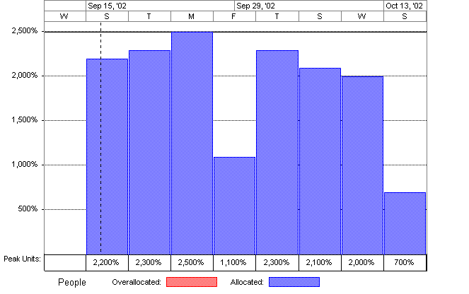
Resource leveling to optimize the schedule
ORIGINAL
LEVELED
20

Slide 21
Project Implementation Plans
Help plan complicated, multi-step tasks
Like your Capstone design project!
Useful when multiple people must plan, coordinate, and execute an assignment
21

Slide 22
Project Implementation Plans
Recommended Sections
Introduction: A description of the opportunity you are investigating and an overview of the types of activities that will be performing during the project
Goals, Objectives, and Deliverables:
  Goal: general and qualitative – a vision type statement
  Objective: Specific and measurable – a quality assurance type statement.
  Deliverable: documents the knowledge generated to achieve the goals or objectives.
Milestones and Tasks: A detailed list and description of all of the tasks you must complete to meet your objectives, organized by deliverable milestones.
Resource Requirements/Project Constraints/Areas of Risk
Project schedule
22

Slide 23




Teamwork and Leadership
Projects almost always involve multiple people and sometimes people from multiple organizations.
This is why we put you in groups in so many different classes. Our stakeholders almost always mention this as the number one item they want us to teach our students.
23

Slide 24
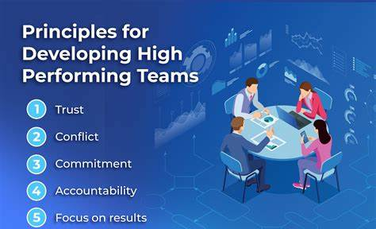
High Performance Teams

Slide 25

Creating and Maintaining a Team Culture
Each individual must . . .
Operate as a team member
Be empowered as individuals
Be accountable for their attitude
Be accountable for their behavior

Slide 26
Personal Accountability: the Key to Empowerment
Empowerment:
The wisdom, ability, and courage to change one’s attitude and behavior in order to effectively respond to new situations.
  Attitude: why we do things
  Behavior: the outcomes of what we do

Slide 27

Judge Others Based on Behaviors
Measure others based on what they accomplish, not on their attitude in the process
Must have a clear vision of the work to be performed and the objectives to be achieved
Compare to objective standards

Slide 28

Setting a Clear Direction
For teams to operate as a cohesive unit, there must be a common sense of purpose and direction
What does the team do? What is the desired level of quality and efficiency? What constraints must we acknowledge?
What roles will each team member assume?
  TEAM ROLES: Facilitation, data gathering, knowledge generation, questioning/quality assurance, documenting

Slide 29

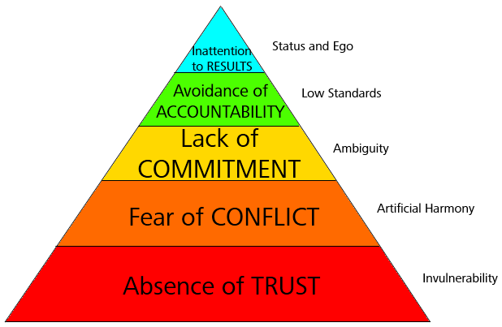
Characteristics of Dysfunctional Team

Slide 30
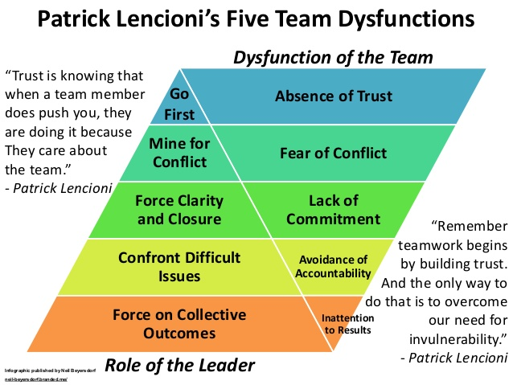
The Leader’s Role in Fixing a Dysfunctional Team

Slide 31
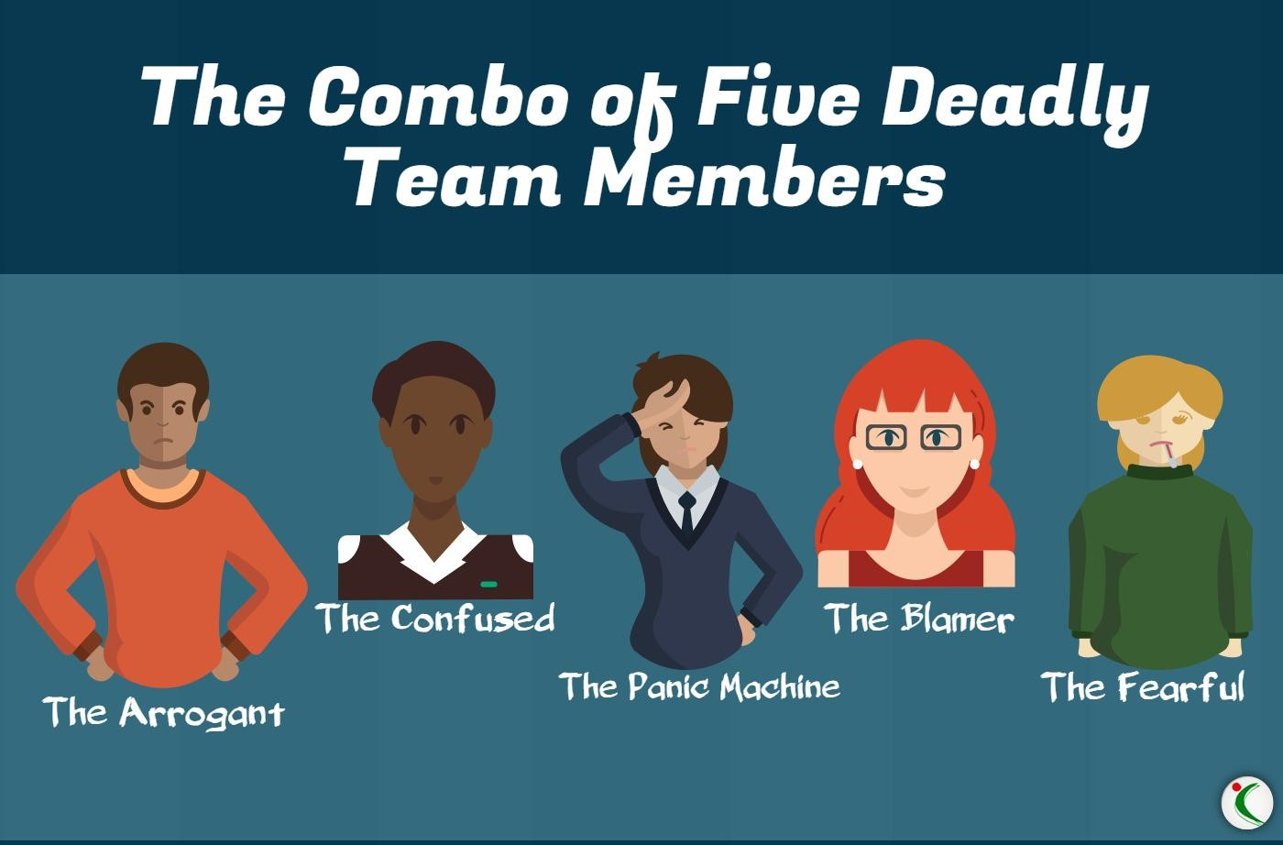
Characteristics of Dysfunctional Team
Try not to be any of these

Slide 32
Summary
Projects are a series of planned activities to evaluate or take advantage of an opportunity
There are specific phases for each project.
Know the phases you are planning/working on.
Know the objectives of that phase(s) – only plan/complete the level of detail needed to meet those objectives
32

Slide 33
Summary
Use a CPM schedule to organize the project and to optimize the use of the resources available to complete the project
Manage to the critical path to stay on schedule
A project implementation plan is a good tool for planning and managing a project.
Develop and maintain a high performance team – not only will the work be higher quality, it’s a lot more fun!
33

Slide 34
An Introduction to
Managing Projects
Questions and Comments

