Slide 1
Super Resolution
(interpolation)

Slide 2



Super Resolution
Zero-order hold (ZOH), sometimes called pixel replication or nearest-neighbour interpolation, is performed by holding each pixel for one additional sample. To double the size of an image, each pixel value is held, or expanded into 4 pixels.

Slide 3

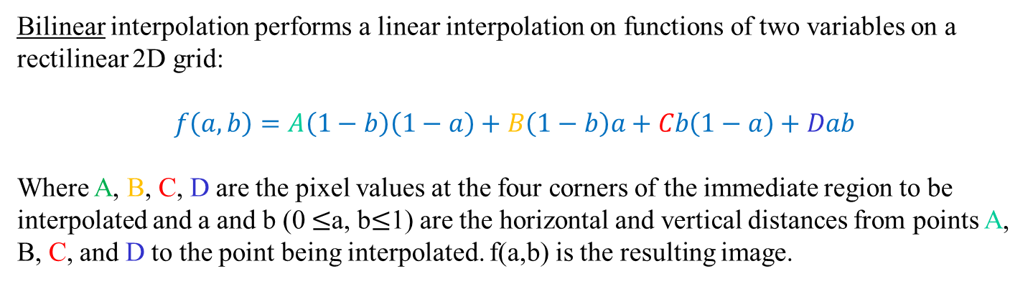
Super Resolution
Bilinear interpolation performs a linear interpolation on functions of two variables on a rectilinear 2D grid:
$$f\left(a,b\right)=A\left(1−b\right)\left(1−a\right)+B\left(1−b\right)a+Cb\left(1−a\right)+Dab$$
Where A, B, C, D are the pixel values at the four corners of the immediate region to be interpolated and a and b (0 $≤$a, b$≤$1) are the horizontal and vertical distances from points A, B, C, and D to the point being interpolated. f(a,b) is the resulting image.

Slide 4

Super Resolution
Bicubic interpolation is often chosen over bilinear interpolation or ZOH, as images resampled with bicubic interpolation are smoother and have fewer interpolation artefacts. The formula for a single linear cubic interpolation is:
$$f\left(p_{0},p_{1},p_{2},p_{3},x\right)=\left(−\frac{1}{2}p_{0}+\frac{3}{2}p_{1}−\frac{3}{2}p_{2}+ \frac{1}{2}p_{3}\right)x^{3}$$
$$+\left(p_{0}−\frac{5}{2}p_{1}+2p_{2}−\frac{1}{2}p_{3}\right)x^{2}$$
$+\left(−\frac{1}{2}p_{0}+\frac{1}{2}p_{2}\right)x+ p_{1}$
Where p₀, p₁, p₂ and p₃ are pixel values located at x=-1, x=0, x=1, and x=2, respectively. Cubic interpolation in two dimensions is performed resulting in two dimensional bicubic interpolation:
$$g\left(x,y\right)=f\left[f\left(p_{00},p_{01},p_{02},p_{03},y\right), f\left(p_{10},p_{11},p_{12},p_{13},y\right), f\left(p_{20},p_{21},p_{22},p_{23},y\right), f\left(p_{30},p_{31},p_{32},p_{33},y\right),x\right]$$
Where p_{ij} are the 16 pixels surrounding the interpolation area, where i and j range from 0 to 3 and p_{ij} located at (i-1, j-1). Thus, we first interpolate the four columns and then interpolate the results in the horizontal direction. g(x,y) is the resulting image.

Slide 5

Super Resolution
Bicubic interpolation

Slide 6

Super Resolution
Directional Cubic Convolution Interpolation (DCCI) adopts to varying edge structures in an image. DCCI first tries to detect edge direction. As certain image textures can make detection of edge directions difficult, the approach employs an estimation method for finding a strong edge for missing pixels which guides the interpolation for that missing pixel. For strong edges, image pixels in non-horizontal and non-vertical edges are smoothened by interpolating the missing pixels. For weak edges in complex regions, it uses a unique interpolation scheme in that two orthogonal directional cubic convolution interpolation results are fused to interpolate the missing pixel.

Slide 7
Super Resolution
Original ZOH Bilinear Bicubic DCCI

Slide 8
Super Resolution
(single-frame)

Slide 9

Super Resolution
Image Zoom Using Corner Matching (MRMA), decides how to color the center pixel on 3x3 overlapping blocks of pixels. We look for an ‘L’ shaped pattern that suggests the center pixel be colored differently from its current value. This pass is intended to reduce cases were ‘jaggies’ should not occur. Effectively, changing the ‘L’ pattern into a triangle pattern. Given a 3x3 block of pixels, this ‘L’ shaped pattern has four possible orientations:
MRMA then uses ZOH to expand the down sampled image back to its original size (with half the resolution).
We then create two arrays (“Value” and “Count”) of the same size as the image. We will refer to these arrays as V and C.
We create a four-element array (“Range”) referred to as R.
We also create another five-element array (“Pattern”) referred to as P. In practice, creating four P arrays, one for each pattern in Fig. 1., makes the algorithm simpler to code.

Slide 10

Super Resolution
Initialize the V array with the ZOH pixel values and the C array with ones.
Assuming four P arrays, we populate the first P array with image pixel values corresponding to the locations of the five grey coloured pixels in the first of the four patterns shown. We populate the second P array with image pixel values corresponding to the locations of the five grey coloured pixels in the second pattern. We populate the third and fourth P arrays in a similar manner using the third and fourth pattern. This process is then convolved across the image, similar to how one would convolve a 3x3 spatial filter across an image.
For each pattern, or array P_{n}, we populate the R array (determine the local range) using:
$$R_{n}=\max\left(P_{n}\right)−\min\left(P_{n}\right)$$
We then determine the minimum range value of the four patterns, using:
$$Smallest=\min\left(R_{n}\right) (23)$$

Slide 11
Super Resolution
If Smallest > 64 none of the four patterns indicate that the centre pixel should be adjusted, we then move on to the next 3x3 block of pixels.
If Smallest <= 64, we determine which of the four patterns resulted in this value (Smallest <= 64) and use that pattern to extract the image pixel values corresponding to the three dark grey pixels.
We then calculate the average of the three dark grey pixels and add this average to the applicable element of the V array. We also increment the applicable element of the C array by 1.
Once have completed this process for every pixel, we recreate the resulting image by dividing the V array by the C array. We do this pixel by pixel.

Slide 12
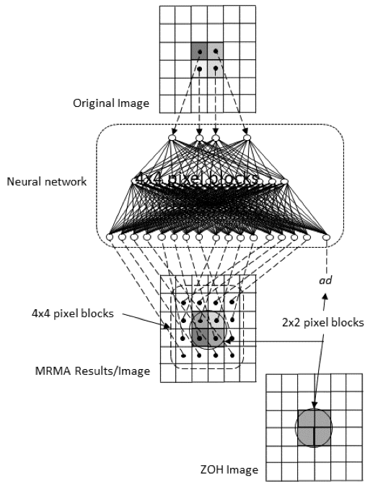
Super Resolution
As a post-processing step, we take note of the fact that, since we averaged 2x2 blocks of pixels to form the lower resolution image, we know the original total energy for pixels in the ZOH image we started the MRMA process with.
The first post-processing step is to apply a neural network trained to perform image interpolation:

Slide 13
Super Resolution
The second post-processing step is to apply a three-stage diffusion algorithm. The first stage determines the difference between the 2x2 block average values of the ZOH image and neural network filtered MRMA image.
The second stage is to perform four Laplace filters on the neural network filtered MRMA image. By four, we mean that we apply the Laplace kernel centred on each of the four pixels comprising each 2x2 block.
The third stage is to calculate and apply the error correction. We calculate four error terms by calculating the absolute value of the difference between the Laplace filter result and the neural network filtered MRMA image. We then sum these four error values together. Finally, for each of the four pixels in each 2x2 block, we multiply the applicable difference between the Laplace filter result and the neural network filtered MRMA image by 0.72 and divide the result by the sum of the four error values. The intent is to use the Laplace filter to find locations where edges have been supressed by the MRMA process and to reinforce those lost edges.

Slide 14

Super Resolution

Slide 15
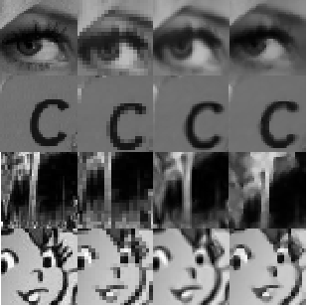
Super Resolution
original ZOH DCCI MRMA

Slide 16
Super Resolution
(multi-frame)

Slide 17
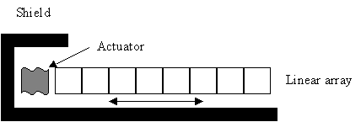
Super Resolution
Assume that a linear detector can be made like:
Assume the detector can be moved rapidly 1/2 pixel back and forth along its axis (fast enough to collect 2 samples of data with in the desired time-frame).
Assume the shield blocks 1/2 of a pixel when the detector is positioned to the left.
Assume that when the detector is positioned to the left a known voltage (kv) is added to the leftmost pixel.
By comparing the data acquired when the detector is positioned to the left and to the right, we can accurately interpolate to sub-pixel (1/2 pixel) accuracy.

Slide 18
Super Resolution
Example:
r (original image data).
100
4
6
8
10
12
14
16
18
20
kv
sL (undersampled data – output from detector shifted to left).
52
7
11
15
19
Note that sL_{i} = (r_{i} + r_{i+1}) / 2 for i = 0…n [e.g. (100+4)/2 = 52].
sR (undersampled data – output from detector shifted to right).
5
9
13
17
Note that sR_{i} = (r_{i} + r_{i+1}) / 2 for i = 1…n [e.g. (4+6)/2 = 5].

Slide 19
Super Resolution
Algorithm:
1. Set p[0] = kv (known signal value).
2. Set p[1] = (2 * sL[0] – p[0])
3. Set p[2] = (2 * sR[0] - p[1])
4. Set p[3] = (2 * sL[1] – p[2])
5. Set p[4] = (2 * sR[1] - p[3])
.
.
.

Slide 20
Super Resolution
Proof:
1. Let kv = 100.
2. Let r = {100, 4, 6, 8, 10, 12, …}
3. Let s1 = {52, 7, 11, 15, 19, …}
4. Let s2 = {5, 9, 13, 17, …}
5. Let p[0] = 100
6. Let p[1] = 2 * 52 - 100
= 4
7. Let p[2] = 2 * 5 - 4
= 6
8. Let p[3] = 2 * 7 – 6
= 8
9. Let p[4] = 2 * 9 - 8
= 10
10. Etc…
We get p[i] = {100, 4, 6, 8, 10, …)
Original image data.
Output from detector shifted to left.
Output from detector shifted to right.
The original data!

Slide 21
Super Resolution
This idea is extendable to 2D (image) data.
If the data is not perfectly ½ pixel sampled one would have to account for this by weighting one sample (left or right) more than the others.
Therefore, given the right circumstances, it is possible to use a low resolution detector, yet get a high resolution image! A result that at first glance would appear to violate the principal of sampling theory.
Dr. Harry Nyquist (University of North Dakota B.S. and M.S. in electrical engineering in 1914 and 1915, respectively) would be shocked.
Results pending!

Slide 22


